Slide 1
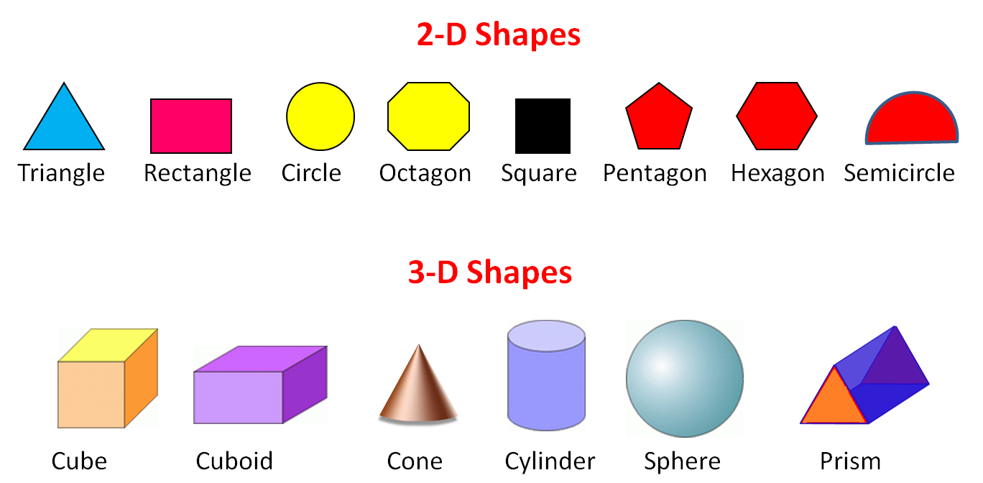
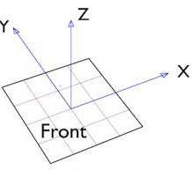
2d and 3d models

Slide 2
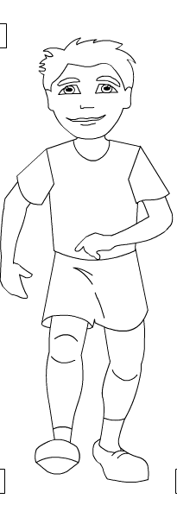

2d image

Slide 3
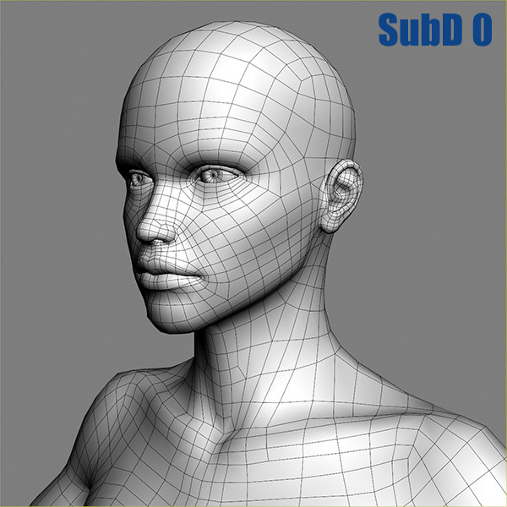
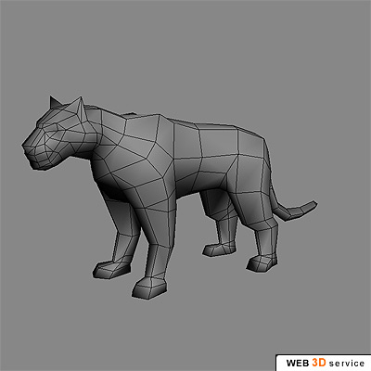
3d image and models

Slide 4
animation
Persistence of vision
Human eye can approximately remember 25 images per second

Slide 5
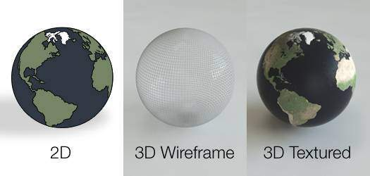

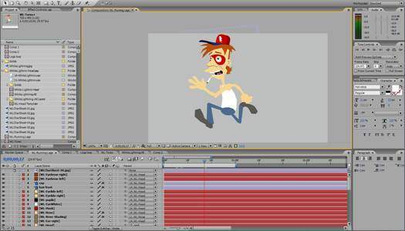
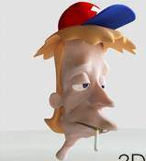
2D and 3D animation
Draw a globe
Draw a sphere.
Write program to rotate it 360⁰

Slide 6
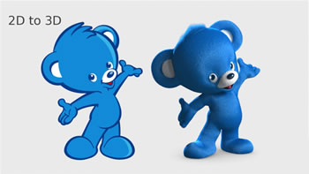
2D ANIMATIONS | 3D ANIMATIONS
Defined over two coordinate System | Defined over three coordinates
Models are usually 2D | Models are 3D
Draw every frame | Prepare model . Move camera in X,Y,Z plane to get 3D view.

Slide 7
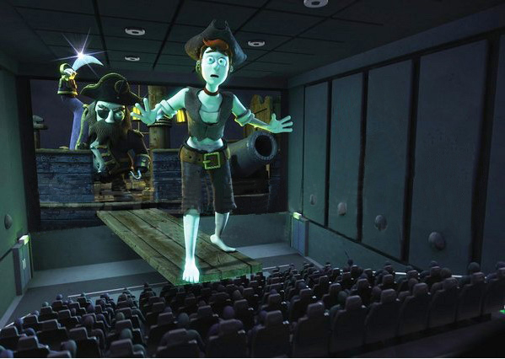
3d movie
Enhances illusion of depth
Camera with Stereoscopic photography records image from different perspectives
A special 3D projector is used to display the video
A special eyewear is used to see the video.
A silver screen is used to provide lots of light and contrast .
Lots of speakers are placed at different angles.

Slide 8
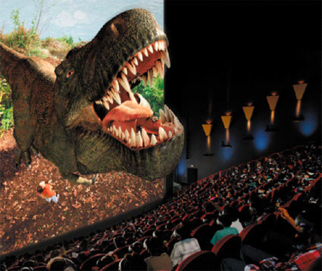
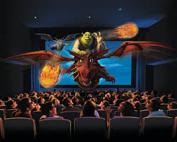
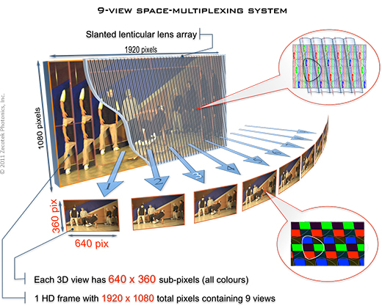
3D display system is broken into several 2D views
Special software multiplex several views into one composite image
Projecting hardware projects certain group of pixels at particular angle.
Special Goggles ensures information belonging to a particular angle is visible from that angle only.

Slide 9
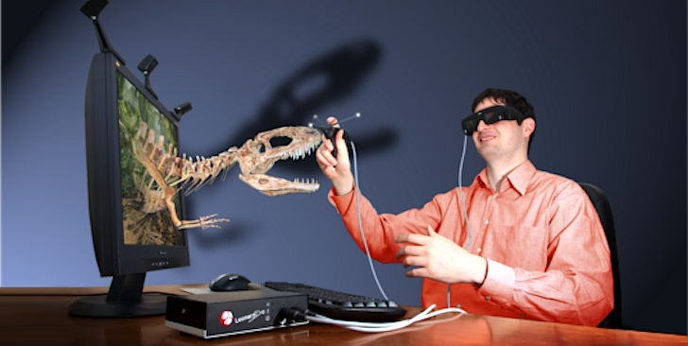
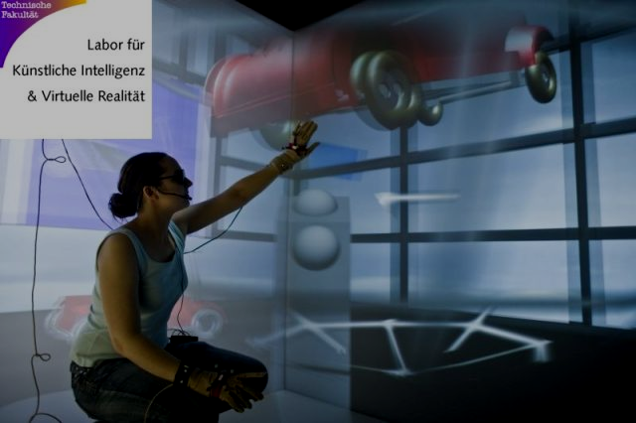
3d virtual reality
A computer simulated artificial environment created with software
User accepts the environment as real.
Simulate the physical presence in imaginary world.
An object can be explored interactively.
Primarily VISUAL through special goggles...some AUDIO through speaker/headphone.

Slide 10
VRML(Virtual Reality Modeling Language) is a language for describing 3D image sequence and possible 3D interaction
Build interactive 3D images…………….view move rotate on 3D screen
View a room as if we are walking.

Slide 11
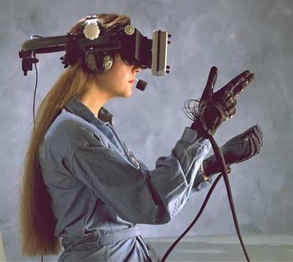
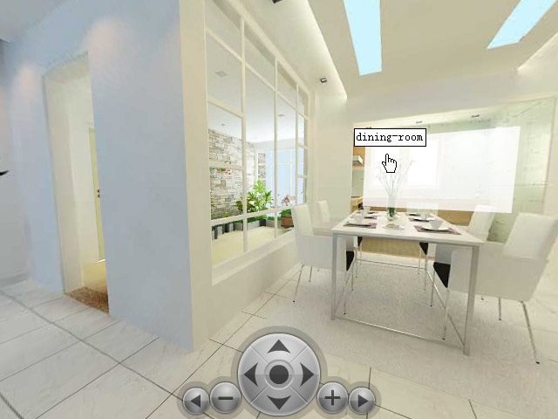
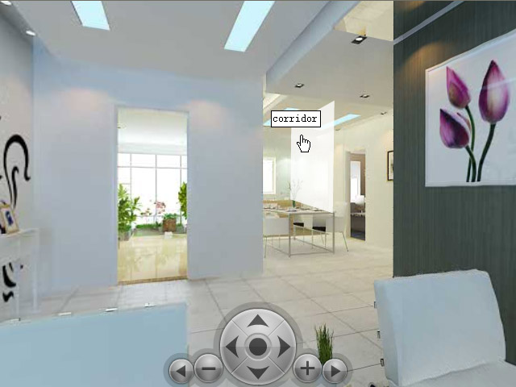
View a room and use control to move

Slide 12
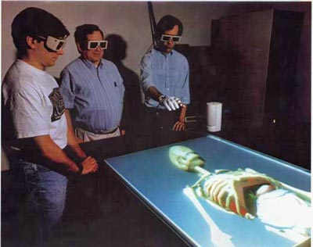
Medical Training
A surgeon can practice operation on 3D virtual patient while surrounded by medical staffs.

Slide 13
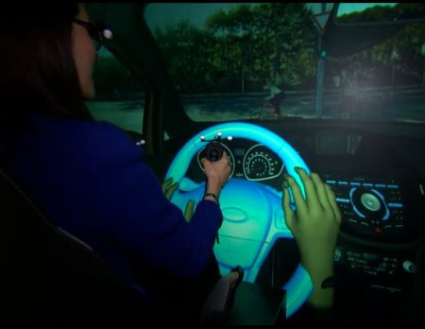
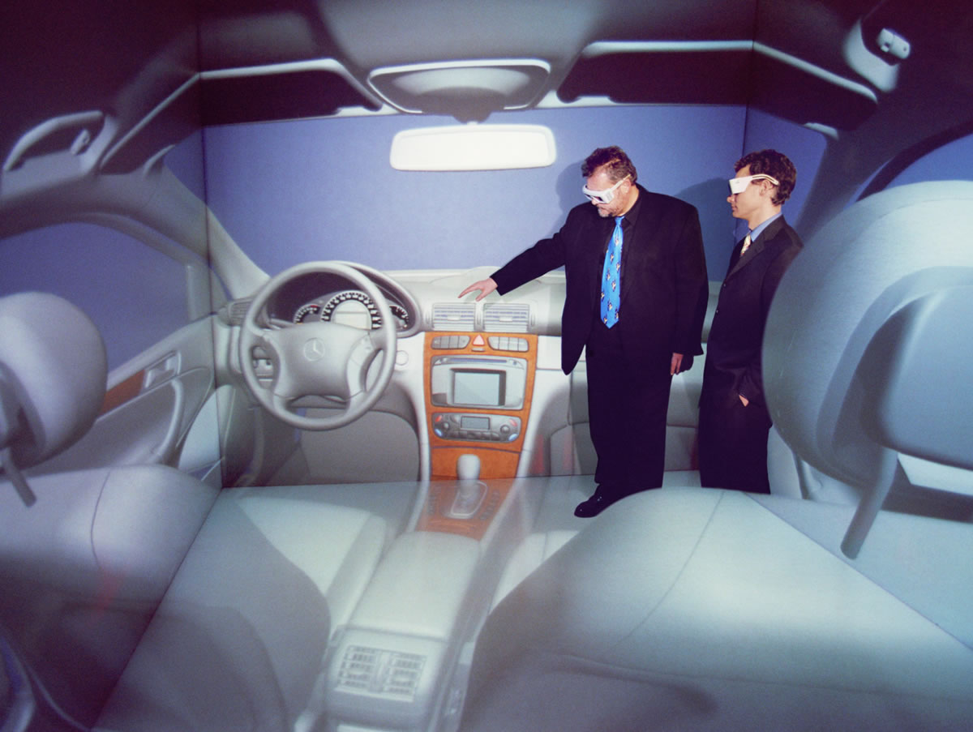
Motor Training
A motor driver can practice driving on 3D virtual car and road

Slide 14
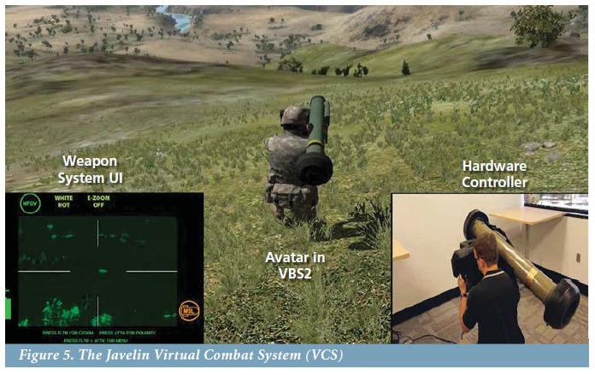
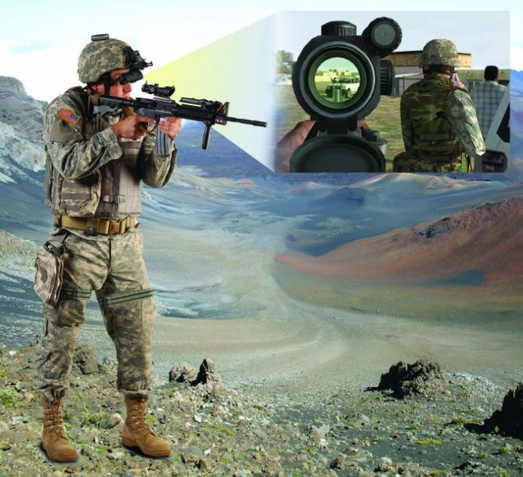
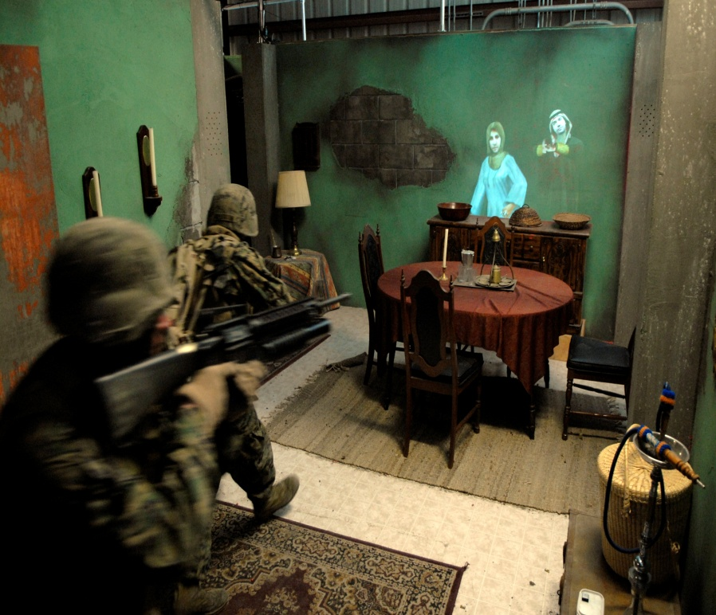
Army Training
A soldier can practice shooting on 3D virtual enemies
on virtual battlefield

Slide 15
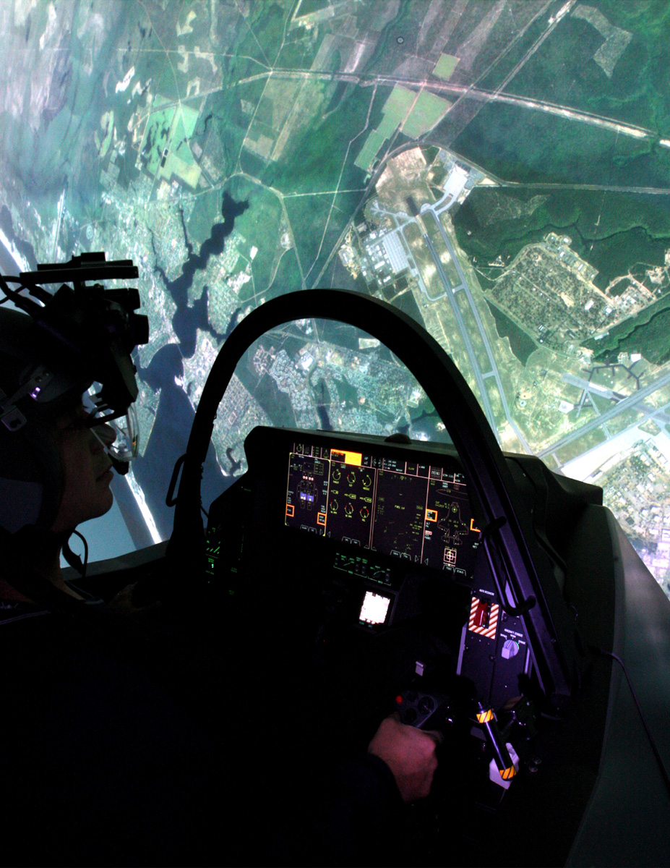
Pilot Training
A pilot fly with virtual plane

Slide 16
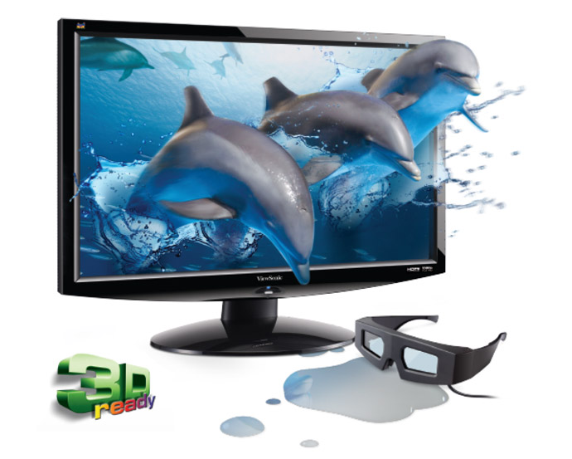
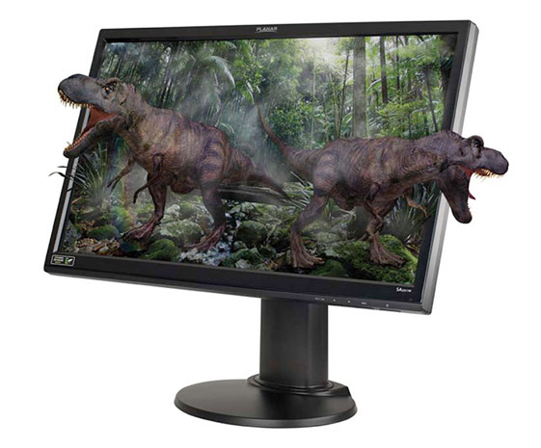
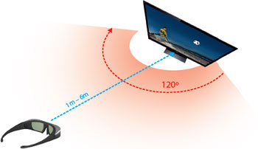
3d monitor
Requires 3D graphics card and 3D goggles
Teach with 3d models and play computer games
3D visualization system and 3D viewing angle

Slide 17
ok

Slide 18
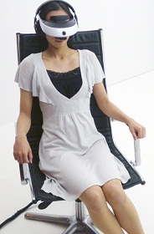
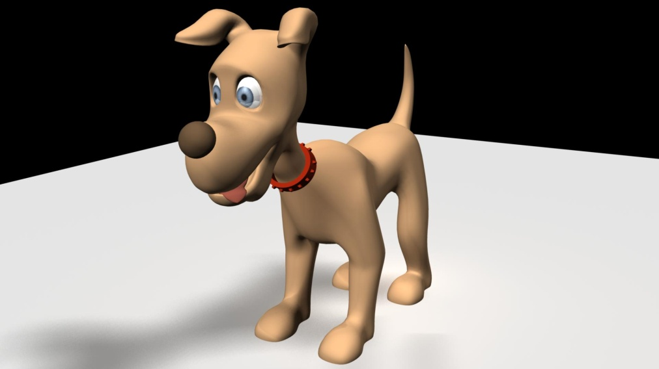
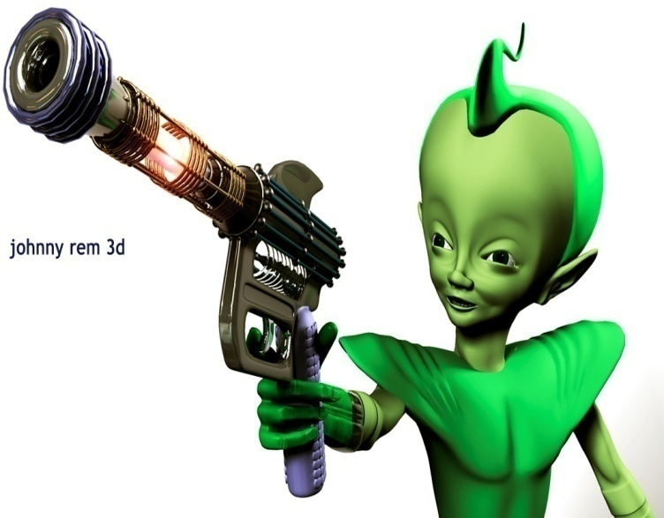


Slide 19
